Slide 1



CONGA: Distributed Congestion-Aware Load Balancing for Datacenters
Mohammad Alizadeh
Tom Edsall, Sarang Dharmapurikar, Ramanan Vaidyanathan, Kevin Chu, Andy Fingerhut, Vinh The Lam★, Francis Matus, Rong Pan, Navindra Yadav, George Varghese§
★
§
Notes:
I’m going to be talking today about work that we’ve been doing over the past couple years on a new load balancing mechanism for datacenter networks.
This is joint work with my colleagues at Cisco, as well as Terry Lam at Google and George Varghese at Microsoft.

Slide 2
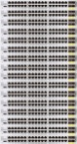
Motivation
DC networks need large bisection bandwidth for distributed apps (big data, HPC, web services, etc)
Multi-rooted tree [Fat-tree, Leaf-Spine, …]
Full bisection bandwidth, achieved via multipathing
Single-rooted tree
High oversubscription
Core
Spine
Agg
Leaf
Access
1000s of server ports
1000s of server ports
Notes:
To set the context, the primary motivation for this work is that datacenter networks need to provide large amounts of bisection bandwidth to support distributed applications; if you consider applications like big data analytics, hPC, or web services, they all require significant network IO between components that are spread across 100s or even 1000s of servers.
In response to this, in recent years, the single rooted tree topologies that have been used in enterprise networks for decades are being replaced with multi-rooted topologies. These new topologies, also called fat-tree or Leaf-Spine, are great -- they can scale bandwidth arbitrarily by just adding more paths; for example, adding more spine switches in a Leaf-Spine design.

Slide 3
Motivation
DC networks need large bisection bandwidth for distributed apps (big data, HPC, web services, etc)
Multi-rooted tree [Fat-tree, Leaf-Spine, …]
Full bisection bandwidth, achieved via multipathing
Spine
Leaf
1000s of server ports
Notes:
So the whole industry is moving in this direction -- of using multi-rooted topologies to build networks with full or near-full bisection bandwidth.
This is great… but if we take a step back, it’s not really what we want.

Slide 4
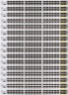
Multi-rooted != Ideal DC Network
Ideal DC network:
Big output-queued switch
Multi-rooted tree
≈
Can’t build it ☹
1000s of server ports
1000s of server ports
No internal bottlenecks ➔ predictable
Simplifies BW management [EyeQ, FairCloud, pFabric, Varys, …]
Need precise load balancing
Possible
bottlenecks
Notes:
A multi-rooted topology is not the “ideal” datacenter network.
What is the ideal network? The ideal network would be a big switch – or more precisely a big output-queued switch. That’s a switch that whenever…

Slide 5

Today: ECMP Load Balancing
Pick among equal-cost paths by a hash of 5-tuple
Approximates Valiant load balancing
Preserves packet order
Problems:
Hash collisions
(coarse granularity)
Local & stateless
(v. bad with asymmetry
due to link failures)
H(f) % 3 = 0
Notes:
Valiant load balancing http://yuba.stanford.edu/vlb/

Slide 6

Dealing with Asymmetry
Handling asymmetry needs non-local knowledge
40G
40G
40G
40G
40G
40G

Slide 7
Dealing with Asymmetry
Handling asymmetry needs non-local knowledge
Scheme | Thrput
ECMP (Local Stateless)
Local Cong-Aware
Global Cong-Aware
30G
(UDP)
40G
30G
40G
40G
40G
40G
(TCP)
40G

Slide 8
Dealing with Asymmetry: ECMP
Scheme | Thrput
ECMP (Local Stateless)
Local Cong-Aware
Global Cong-Aware
30G
(UDP)
60G
40G
30G
40G
10G
20G
40G
40G
20G
40G
(TCP)
40G

Slide 9
Dealing with Asymmetry: Local Congestion-Aware
Scheme | Thrput
ECMP (Local Stateless)
Local Cong-Aware
Global Cong-Aware
30G
(UDP)
60G
40G
30G
50G
40G
10G
40G
40G
20G
Interacts poorly with TCP’s control loop
10G
40G
(TCP)
40G

Slide 10
Dealing with Asymmetry: Global Congestion-Aware
Scheme | Thrput
ECMP (Local Stateless)
Local Cong-Aware
Global Cong-Aware
30G
(UDP)
60G
40G
30G
50G
70G
40G
10G
5G
Global CA > ECMP > Local CA
40G
40G
10G
35G
40G
(TCP)
40G
Local congestion-awareness can be worse than ECMP

Slide 11
Global Congestion-Awareness (in Datacenters)
 | Datacenter
Latency | microseconds
Topology | simple, regular
Traffic | volatile, bursty
Simple & Stable
Opportunity
Challenge
Responsive
Key Insight:
Use extremely fast, low latency
distributed control
Notes:
Why? Well, a fast distributed control would naturally be very responsive and be able to quickly adapt to changing traffic demands.
At the same time, as I’ll show later, it exploits exactly the good properties of the datacenter --- low latency and simple network topologies --- to enable a simultaneously simple and stable solution.

Slide 12
CONGA in 1 Slide
Leaf switches (top-of-rack) track congestion to other leaves on different paths in near real-time
Use greedy decisions to minimize bottleneck util
Fast feedback loops between leaf switches, directly in dataplane
L0
L1
L2

Slide 13
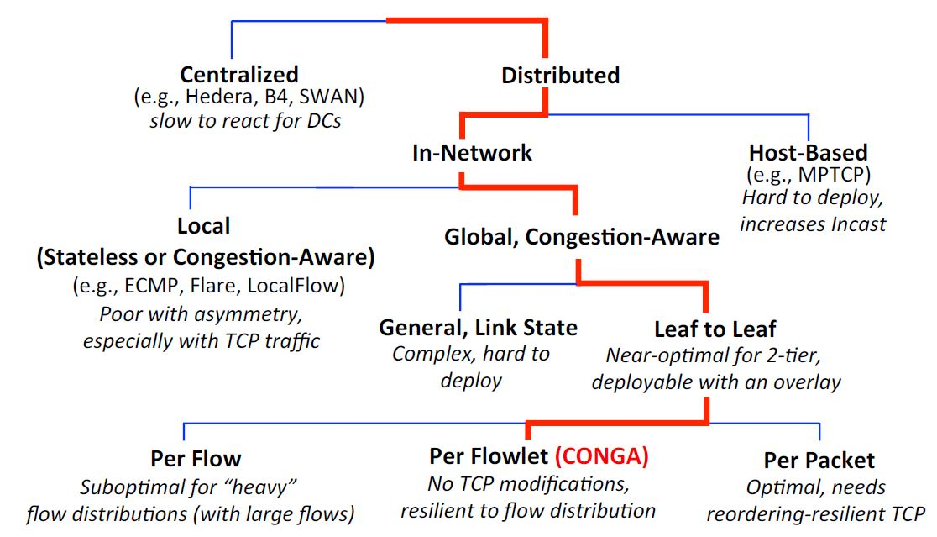
Design Space for Load Balancing

Slide 14
Conga’s design

Slide 15
Design
CONGA operates over a standard DC overlay (VXLAN -Virtual Extensible LAN)
Already deployed to virtualize the physical network
VXLAN encap.
L0➔L2
H1➔H9
L0➔L2
H1➔H9
L0
L1
L2
H1
H2
H3
H4
H5
H6
H7
H8
H9
Notes:
CONGA operates over a standard datacenter overlay, like VXLAN, that is used to virtualize the physical network.
I don’t have too much time to spend on overlays, but the basic idea is that there are these standard tunneling mechanisms, such as VXLAN, that are already being deployed in datacenters, and provide an ideal conduit for implementing CONGA.

Slide 16

Design: Leaf-to-Leaf Feedback
Track path-wise congestion metrics (3 bits) between each pair of leaf switches
Rate Measurement Module
measures link utilization
L0➔L2
Path=2
CE=0
L0➔L2
Path=2
CE=5
pkt.CE ⬅ max(pkt.CE, link.util)
Path
Path
3
3
2
0
1
2
0
1
Dest Leaf
2
Src Leaf
5
3
7
5
L1
L0
1
1
5
4
L2
L1
Congestion-To-Leaf
Table @L0
Congestion-From-Leaf
Table @L2
L0➔L2
Path=2
CE=0
L2➔L0
FB-Path=2
FB-Metric=5
L0➔L2
Path=2
CE=5
0
1
3
2
L0
L1
L2
CE: congestion extent
H1
H2
H3
H4
H5
H6
H7
H8
H9

Slide 17
Design: LB Decisions
Send each packet on least congested path
flowlet [Kandula et al 2007]
Path
3
0
1
2
Dest Leaf
2
5
3
7
L1
1
1
5
4
L2
Congestion-To-Leaf
Table @L0
L0 ➔ L1: p* = 3
L0 ➔ L2: p* = 0 or 1
0
1
3
2
L0
L1
L2
H1
H2
H3
H4
H5
H6
H7
H8
H9

Slide 18
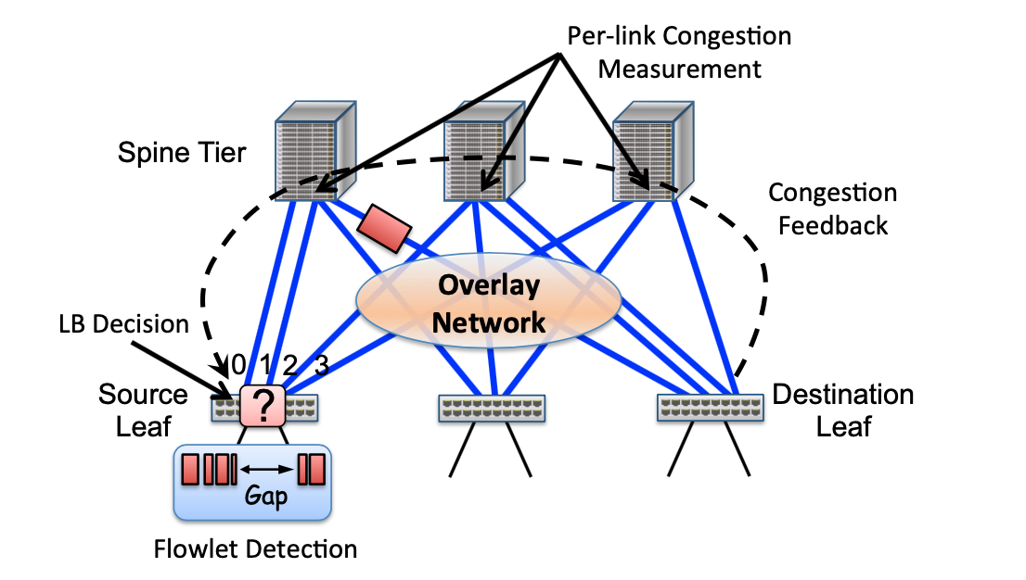
Flowlets for finer load balancing
The source leaf switch detects flowlets and routes them via the least congested path to the destination using congestion metrics obtained from leaf-to-leaf feedback.

Slide 19
Flowlet table update
When a packet arrives, if valid_bit = 1, the flowlet is active and the packet is sent on the port indicated in the entry. If the entry is not valid, the incoming packet starts a new flowlet.
Each incoming packet resets the age bit. A timer periodically (every T seconds) checks the age bit before setting it. If the age bit is set when the timer checks it, then there have not been any packets for that entry in the last T seconds and the entry times out (the valid bit is set to zero). Note that a single age bit allows us to detect gaps between T and 2T.
Flowlet Table
Port # | Valid bit (V) | Age bit (A)
Each entry pointed by
a 5-tuple hashed value
timeout
A=0
Gap = 2T
A=1
A=1
V=0
packet
A=0
Gap = T
A=1
A=1
V=0

Slide 20
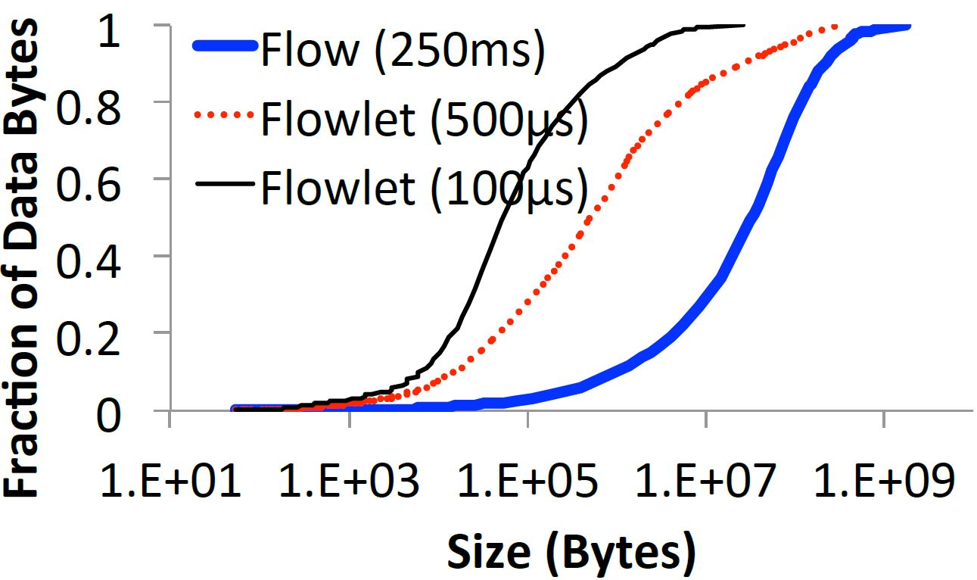
Distribution of data bytes across transfer sizes for different flowlet inactivity gaps
- 50% of the bytes are in flows larger than 30MB, but this number reduces to 500KB for “Flowlet (500micro-sec)” – much finer granularity
- Entry of the flowlet table: an output port no., a valid bit, and an age bit.

Slide 21
Why is this Stable?
Stability usually requires a sophisticated control law (e.g., TeXCP, MPTCP, etc)
Source Leaf
(few microseconds)
Dest Leaf
Feedback Latency
Adjustment Speed
(flowlet arrivals)
Near-zero latency + flowlets ➔ stable
Notes:
Observe changes faster than they can happen

Slide 22
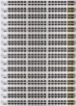



How Far is this from Optimal?
bottleneck routing game
(Banner & Orda, 2007)
Given traffic demands [λ_{ij}]:
with CONGA
Worst-case
Price of Anarchy
L0
L1
L2
H1
H2
H3
H4
H5
H6
H7
H8
H9
Theorem: PoA of CONGA = 2
Notes:
Say PoA: Is the price of uncoordinated decision making

Slide 23
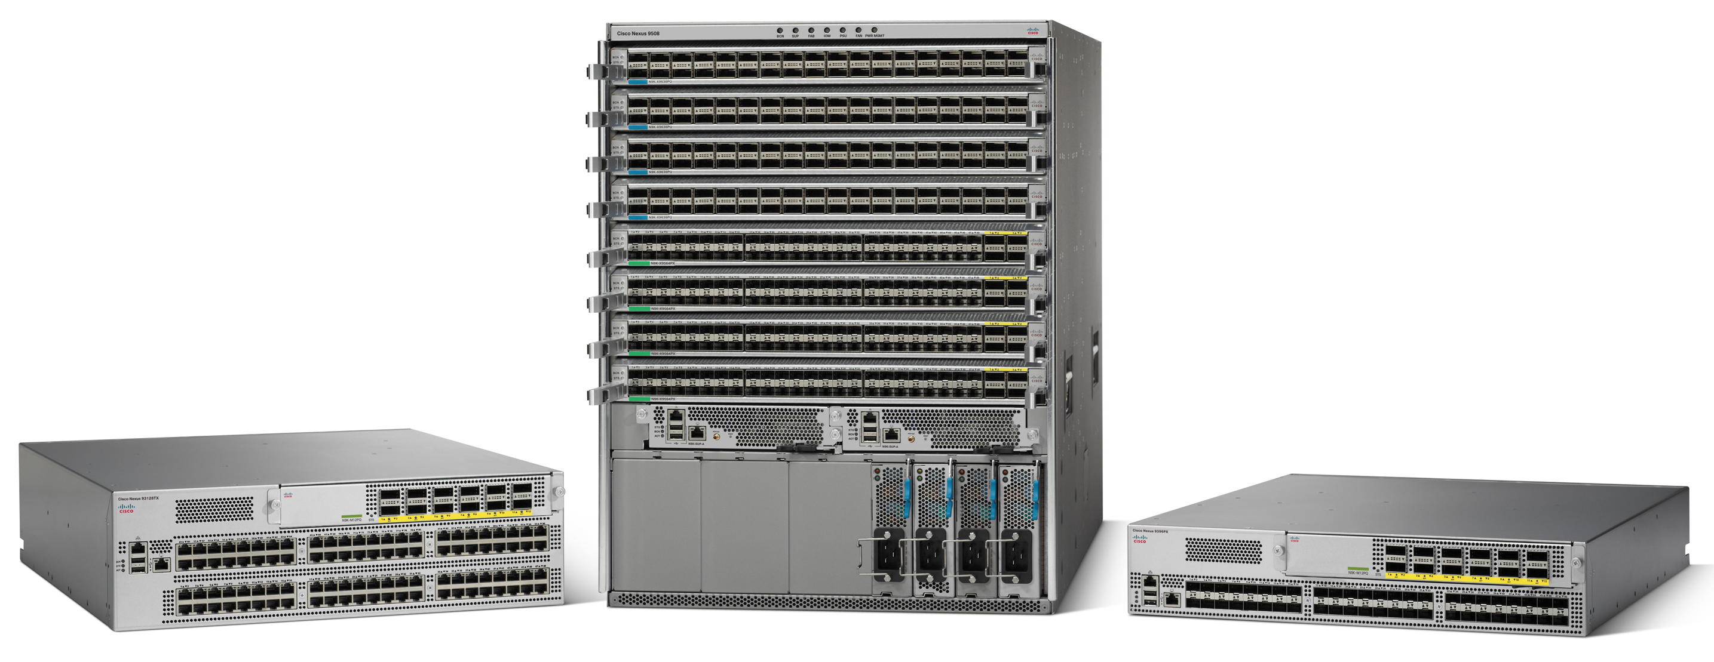

Implementation
Implemented in silicon for Cisco’s new flagship ACI (Application Centric Infrastructure) datacenter fabric
Scales to over 25,000 non-blocking 10G ports (2-tier Leaf-Spine)
Die area: <2% of chip

Slide 24
Evaluation
Link Failure
40G fabric links
32x10G
32x10G
32x10G
32x10G
Testbed experiments
64 servers, 10/40G switches
Realistic traffic patterns (enterprise, data-mining)
HDFS benchmark
Large-scale simulations
OMNET++, Linux 2.6.26 TCP
Varying fabric size, link speed, asymmetry
Up to 384-port fabric

Slide 25

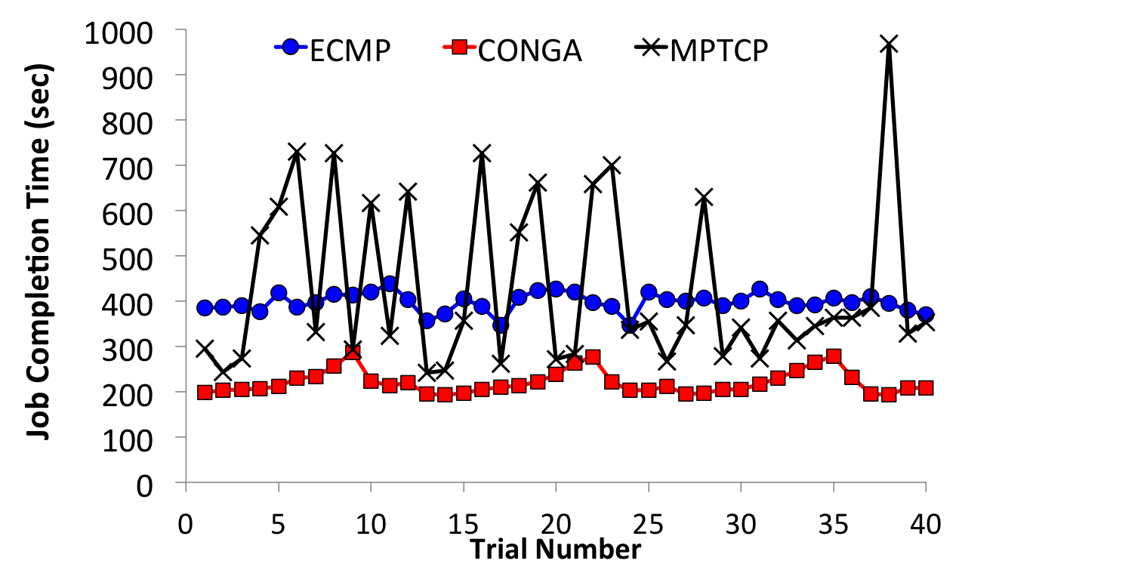
HDFS Benchmark 1TB Write Test, 40 runs
Cloudera hadoop-0.20.2-cdh3u5, 1 NameNode, 63 DataNodes
no link failure
~2x better than ECMP
Link failure has almost no impact with CONGA

Slide 26
Decouple DC LB & Transport
Big Switch Abstraction
(provided by network)
H1
H1
H2
H2
H3
H3
H4
H4
H5
H5
H6
H6
H7
H7
H8
H8
TX
H9
H9
RX
ingress & egress
(managed by transport)

Slide 27
Conclusion
CONGA: Globally congestion-aware LB for DC
… implemented in Cisco ACI datacenter fabric
Key takeaways
In-network LB is right for DCs
Low latency is your friend; makes feedback control easy
Notes:
Network-based lb is architecturally right
Simple distributed, but hardware accelerate mechanisms are near-optimal

